Slide 1
Sibbir Sihan
Microsoft Certified Data Engineer
NHS Dorset Lead Data Engineer
British Civil Service
American Silicone Valley Software Company
AG: Largest RMG Denim Manufacturer in the world

Slide 2
What I am doing right now!
NHS Dorset Lead Data Engineer
Maintaining data platforms- sql servers, DWs, ETL loads, Power BI Administrations
Azure Resources Management
Cost Calculations and R&D in prospective tools.
Writing ETL codes, configuring ADF pipelines and Building Power BI Reports
Implementing Governance Guidelines and Best Practices as well as Quality Assurance Guidelines.
Security Implementations.

Slide 3
Agenda
01
Implementing Enterprise Power BI at Mid Yorkshire NHS Trust
Looking at my one tiny project
02

Slide 4

Implementing Enterprise Power BI
01

Slide 5
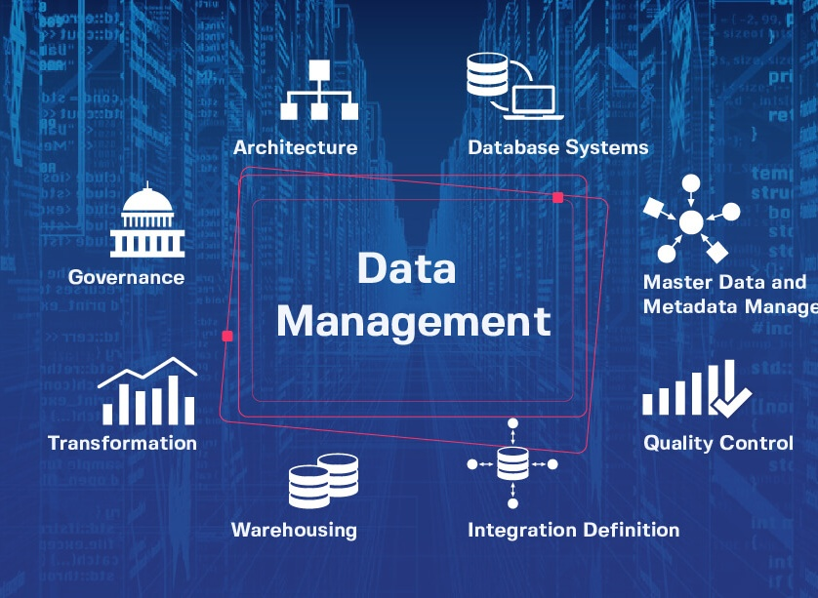
Goal
Strategizing an Enterprise Grade Power BI implementation
Scalable, Secure and highly available data assets
Discuss the Data Architecture, Best Practices for Power Bi Development and Deployments
Measures to be taken to ensure highest level of security
Monitoring of ETL Pipelines and Power BI Reports Usage

Slide 6
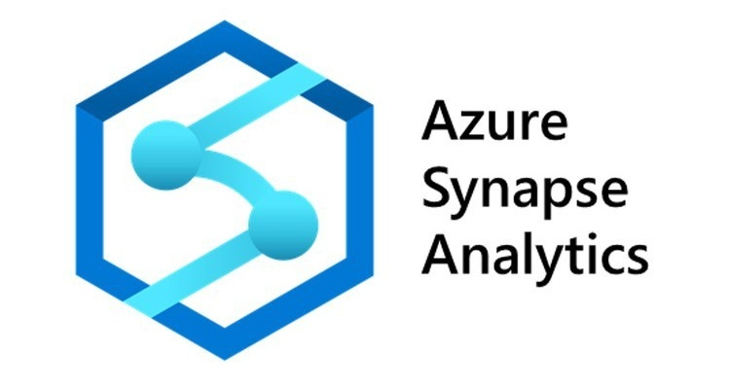

Assumptions and Budget Considerations
Azure and SQL Heavy
Power BI Eco Heavy
Not strict requirements but Easy to adopt if-
Already using SQL Server, Synapse
Using ADF as an integration tool
Team’s expertise only in T-SQL
Ready to pay for Azure Resources
Does not have any Fabric SKU purchased
Not strict requirements but Easy to adopt if-
Very Small number of data engineers
Completely new solution, little experience with Azure Eco system
A lots of Power BI Developer
Members keen on continuous learning
Does not have any Fabric SKU purchased
Ready to quickly upskill and learn new modern tools

Slide 7

Power Bi Eco Heavy

Slide 8
DATA ENGINEERING
POWER BI DEVELOPMENT
REPORTING ESTATE
Need a way to maintain the data ingestion, cleaning and modelling
A data warehouse where data is finalised for Power Bi Consumption
Maintain Extract, Transform and Load logics
Implementing Slow Changing Dimension in Code to load data into Warehouse
A way to save analytical cost by implementing Kimball Data Model at Warehouse

Slide 9
Data Engineering Architecture
(if you do not have one already)
Lakehouse Architecture
Sandbox
Bronze (Fabric LH)
Silver (Fabric LH)
Gold (Fabric DW)
DATA ENGINEERING
Blob
SQL Servers
ERPs
ADF/
SSIS
Deployment Pipeline (CICD) Git Integration on Azure DevOps YAML Pipeline to call Fabric Rest API to auto deploy from Environments
ETL logics in Notebooks
Notebooks Orchestration in Data Pipeline
Test/Live
Bronze (Fabric LH)
Silver (Fabric LH)
Gold (Fabric DW)
Blob
SQL Servers
ERPs
ADF/
SSIS
ETL logics in Notebooks
Notebooks Orchestration in Data Pipeline

Slide 10
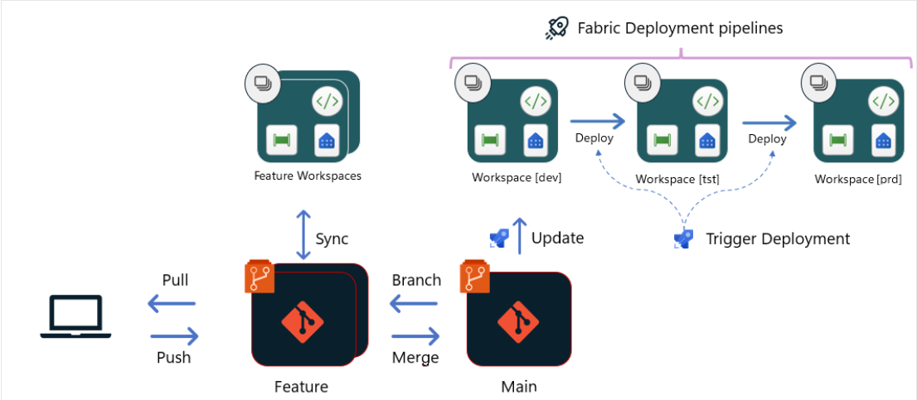
Power BI Development Only
Power BI Development
.pbip
Git Repo
Deployment Pipeline (CICD) Git Integration on Azure DevOps YAML Pipeline to call Fabric Rest API and PowerShell to auto deploy from Git and Stages

Slide 11
Best Practices for Data Engineering
Logging Database for ETL
Silver LH, Bronze LH, Gold WH
SparkSQL for SCD Logic
Purview to ensure Data Quality – scanning, alerts etc.
Auto Copy of Hotfix branch using Azure DevOps pipeline – ensure Main Branch Backup
When Hotfixes are done, Like the Dev Workspace to new Hotfix Branch until the updates are brough into main branch.
All the Basic SQL DML, DDL or any SQL keywords will be Uppercase
Pascal Case for Column Names ( e.g. UserID, PatientName)
Clear and elaborated Naming Convention
Avoiding Merged Into Statement for Performance boost
Creating Index on LH frequently Joined columns. E.g. “OPTIMIZE patients ZORDER BY (patient_id)”
Partitioning on LH on Low Cardinality Column. Like Months or Regions.

Slide 12
Best Practices for Power BI (Part 1)
Disable Auto-Load:
If you're not actively using a query, disable auto-loading to avoid unnecessary processingPower BI's Performance Analyzer can help identify performance bottlenecks in your report.
Keep DAX measures simple:
Complex DAX measures can slow down calculations. Start with simple aggregations and then add complexity as needed.
Use a star schema:
A star schema can improve query performance by organizing data into fact and dimension tables.
Use DirectQuery:
If you have a large dataset and don't need to import the entire dataset, explore using DirectQuery to retrieve data in real-time.

Slide 13
Best Practices for Power BI (Part 2)
Filter early:
Apply filters and transformations as early as possible in the query to reduce the amount of data processed.
Incremental Refresh
Datamarts:
For complex Power Query and Power Bi transformation, use datamarts on the sql server or DW. If you do use native query, then get a datamart done by data engineers.
Turn off default visual interactions if not needed.
No to calculated tables;
No Dataflow;
Get a datamart in place. Use Lakehouse or DW to bring data in.
Row Level Security in Power BI

Slide 14
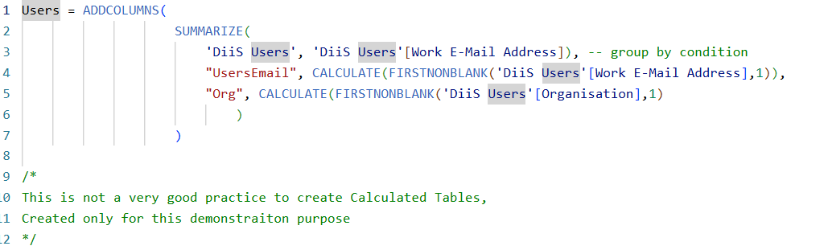
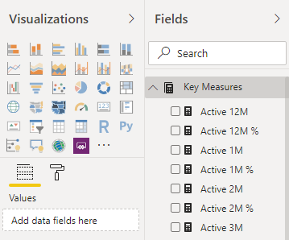
Styling for Power BI
DAX
Measures Table

Slide 15
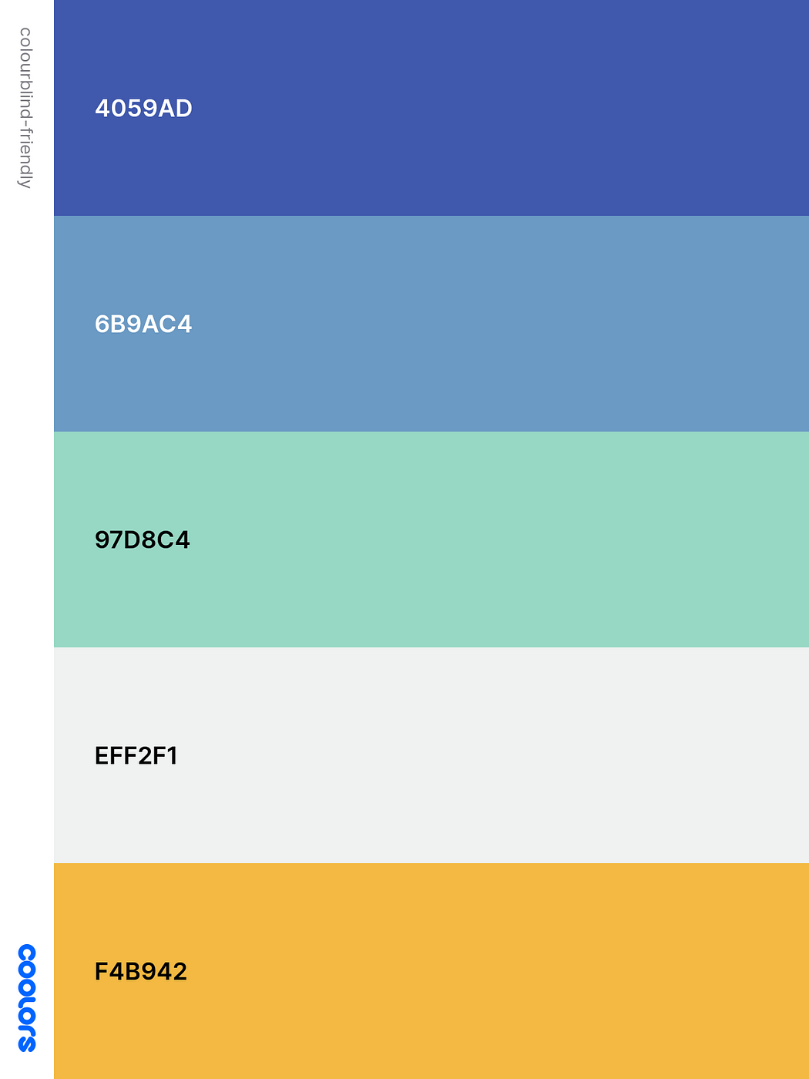
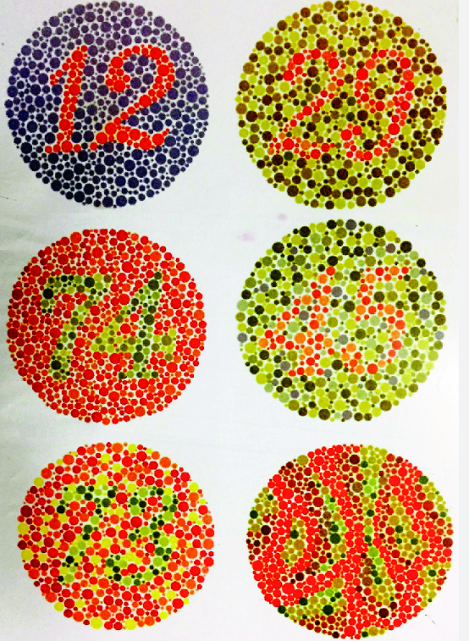
Styling for Power BI
Colour-blind Friendly Colours

Slide 16
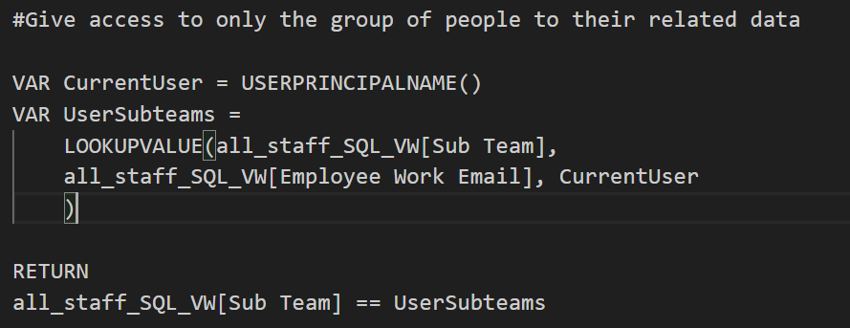
Styling for Power BI
Avoiding mixing Red and Green in one Visual
Keep Visuals simple, consisting basic chart types
Avoid using Pie Chart when exceeds 4 slices
Clear and Descriptive column and measure names
A corporate theme .json in a handy location
Using a template for starters
Group Level/ Region Level Row Level Security through DAX

Slide 17
MANY ways of implementing a data INFRASTRUCTURE, we just talked about one APPROACH.

